Slide 1
AngularJS
Shared and Isolate Scope
Lecture 2
By James(Jin) Wang
08/08/2019

Slide 2
Outline
Understanding Shared and Isolate Scope
@ Local Scope Property
= Local Scope Property
& Local Scope Property

Slide 3
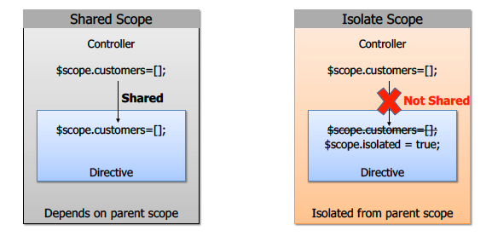
Understanding Shared and Isolate Scope

Slide 4
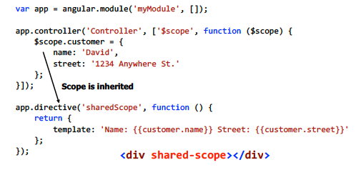
Understanding Shared and Isolate Scope
  Shared Scope Directive Example

Slide 5
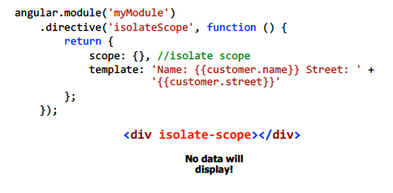
Understanding Shared and Isolate Scope
  Isolating Scope in Directives
  Demo: share & isolate scope

Slide 6
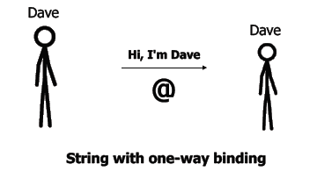
@ Local Scope Property
  @ Local Scope Property

Slide 7
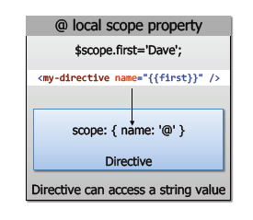
@ Local Scope Property
  Demo: @ scope

Slide 8
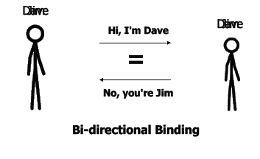
= Local Scope Property
  = Local Scope Property

Slide 9
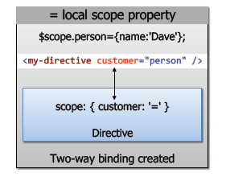
= Local Scope Property
  Demo: = scope

Slide 10
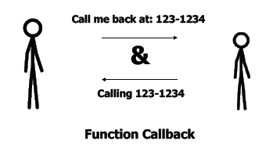
& Local Scope Property
  & Local Scope Property

Slide 11
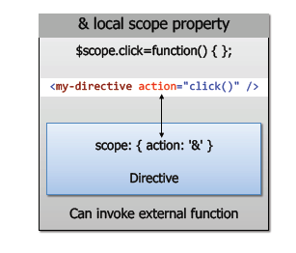
& Local Scope Property
  Demo: & scope

Slide 12
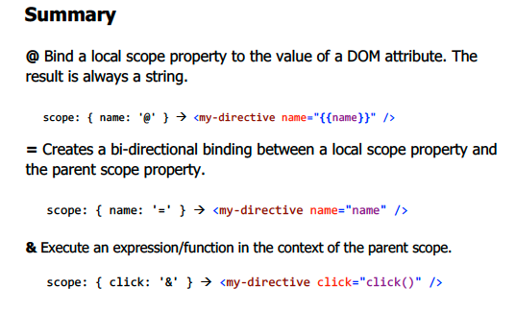
Shared and Isolate Scope

